Slide 2
Circular Economy in Turkey

Slide 3
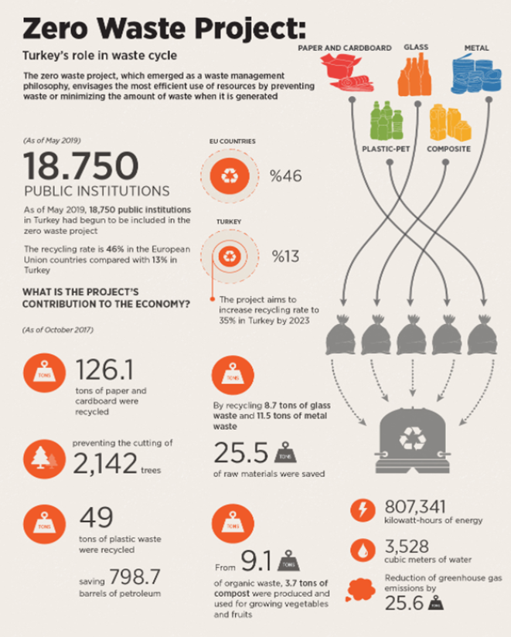
Government Perspective and Action on Circular Economy in Turkey
The Zero Waste (2017)
Ministry of Environment and Urbanization
The recycling rate is %46 in the European Union countries compared with %13 in Turkey. The project aims to increase that ratio to %35 in Turkey by 2023.

Slide 4
Government Perspective and Action on Circular Economy in Turkey
The legal framework on waste management is partially aligned with the new EU acquis.
Turkey adopted a strategy promoting a zero waste management approach.
A ban on the free distribution of lightweight plastic bags came into force in January 2019
The affords for bringing the waste treatment facilities up to EU acquis standards continues.
Turkey plans to introduce a deposit fee for plastic bottles by 2021.
Turkey extended the previous recycling and re-use targets initially defined by the end of 2020. And now it covers the years, 2021-2031 and beyond 2031.

Slide 5
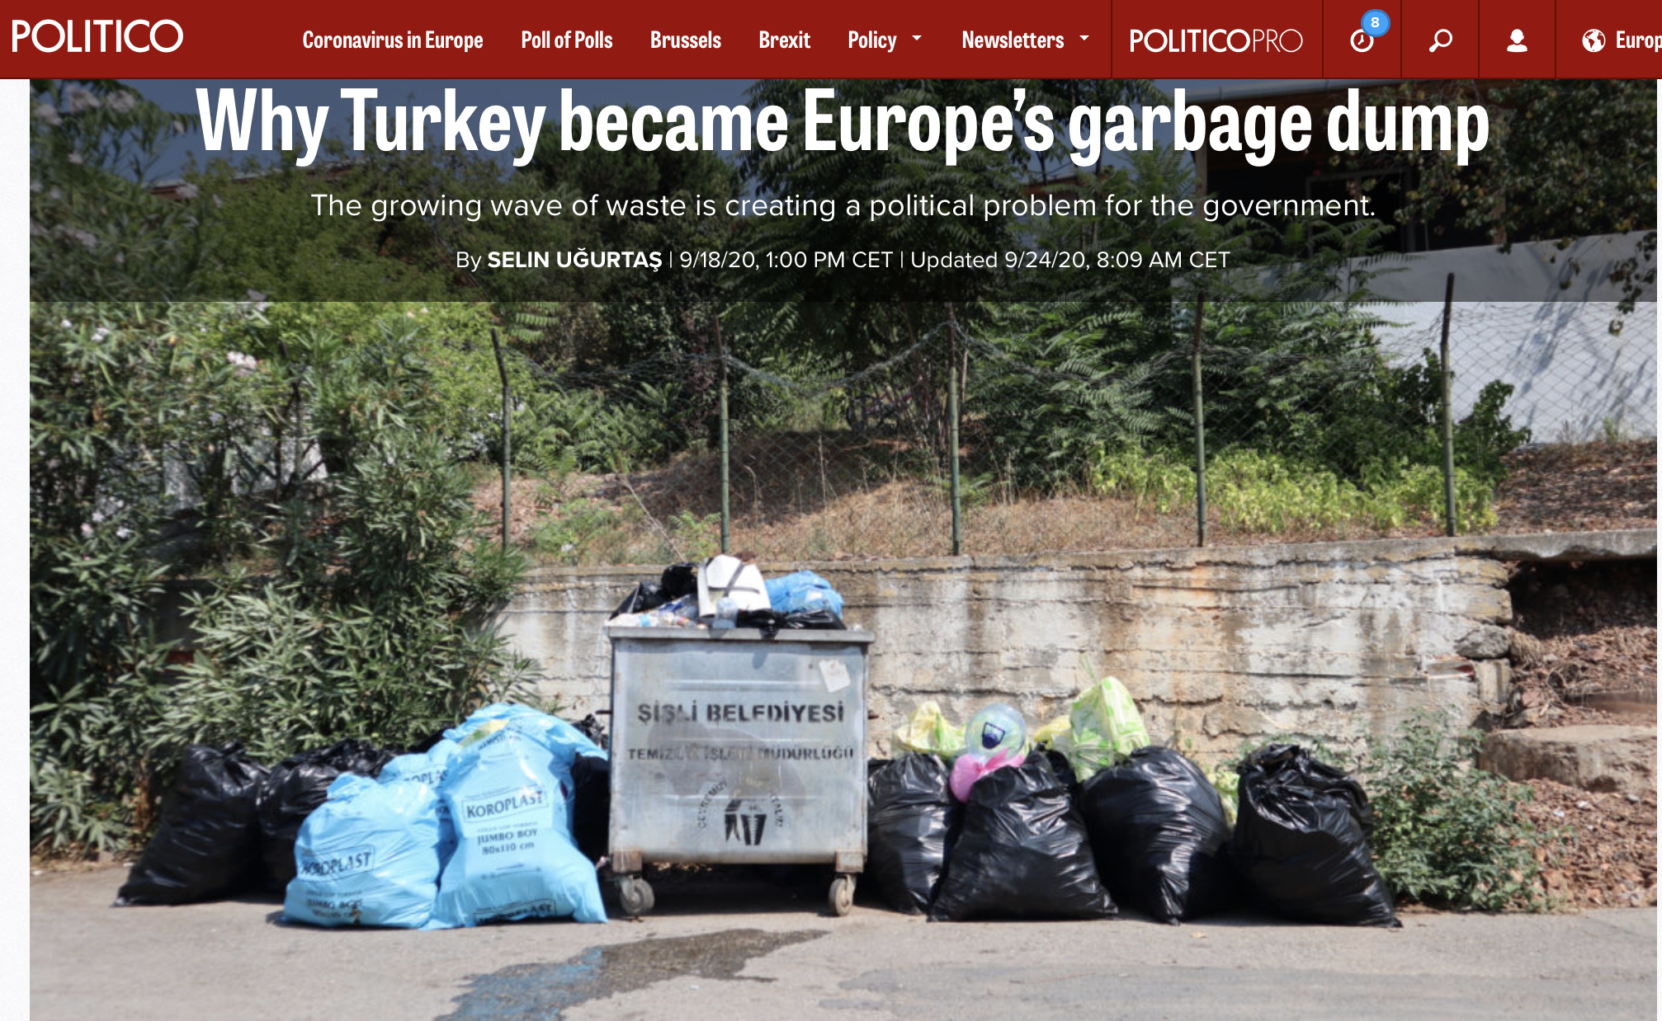
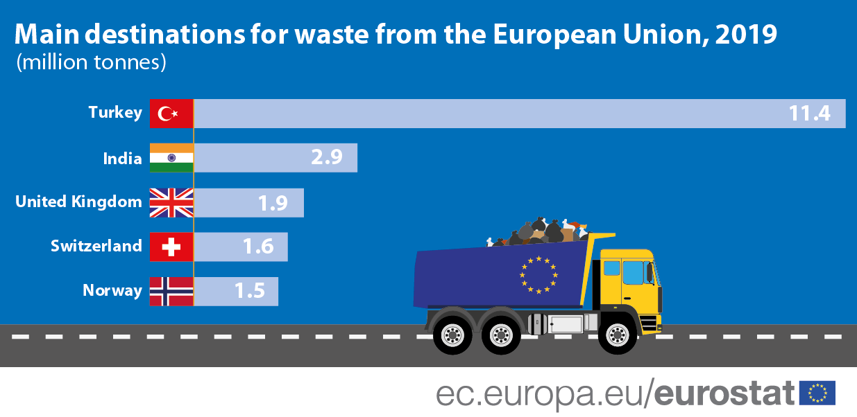
Contradictions
Turkey is the largest destination for waste exported from the EU, with a volume of around 11.4 million tonnes in 2019. This is almost three times more than it was in 2004.

Slide 6
Main Barriers and Obstacles
Lack of policies towards sustainable and circular economy
Lack of legislation for efficient CE
Financial incentives of the government are prepared towards the linear economy
Lack of government support for environmentally friendly policies
Lack of standards for assessing the CE performance
Lack of recycling and recovery infrastructure
Complex regulatory and legal requirements made it difficult to use and trade waste
Lack of attitude and awareness about CE in the government institutions
Failure to raise awareness in the society regarding circular economy
Lack of mandatory requirements and responsibilities for manufacturers/ suppliers for the CE
.

Slide 7
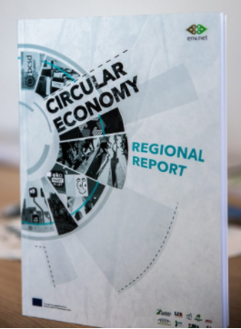
INSIGHT, ANALYSIS & PUBLICATION
EDUCATION & TRAINING
BEST PRACTICES
Inspiring learners to re-think the future through the circular economy framework
Developing the conceptual framework and celebrating best practice
Providing robust evidence about the benefits of the circular economy transition

Slide 8
THANK YOU!

