Slide 2
Circular Economy in North Macedonia: Current context
In the Republic of North Macedonia, even though the notion of “circular economy” has only recently (and explicitly) entered in the legal framework the concept of circularity in the economy is not entirely new.
The use of secondary row materials as resources, in particular various types of metal and paper, has been long present in the country economic cycle of production and trading activities.
The current legal environment that profiles the circularity of the economy, defined by a corpus of laws, regulations, and strategic national documents and action plans, does provide basis for implementation of the concept of circular economy in the country.
The interest of the wider society, including scholars, researchers, NGOs and media, relating to circular economy potentials and practices in the country has also been present and increasing in the past several years, manifested in a form of case studies, conferences, media articles and CSO initiatives that explicitly target the concept of CE.

Slide 3
Findings
Using the approach and logic of the EU proposed Monitoring framework and indicators, key can be summarised as following:
Production and consumption - Limited progress can be observed towards more circular trends in production and consumption, in terms of waste generation.
Waste Management - Waste management generally shows slow but positive developments, yet with significant room for improvement for recycling across the key waste streams.
Secondary raw materials - The contribution of recycled materials to overall materials demand is relatively low. Trade in secondary raw materials is increasing.
Competitiveness and innovation - Republic of North Macedonia is categorised as a "modest innovator" compared to other European countries (Over time, performance has increased relative to that of the EU, and 2020 it increased by 10.8 index points compared to EU in 2012, but 4 index points behind compared to EU in 2019.

Slide 4
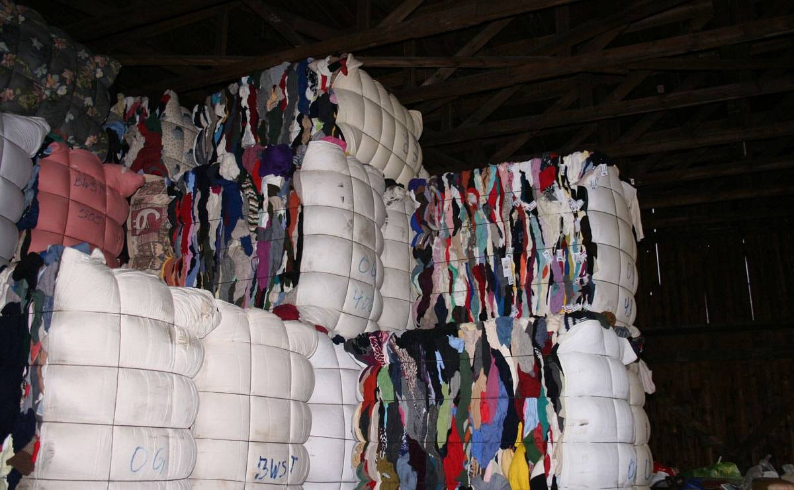
CE Initiatives in North Macedonia
“Trash for Cash” initiatives : Reverse Vending Machines:
All residents who will be involved in this process of selective waste disposal will receive subsidies (a certain amount of money on the new Green Pay Card), allowing them to buy with discounting in certain markets, shops, bars, etc., or to pay for the services provided by the parking company.
Making insulation materials from textile waste: The company Netam from Skopje manufactures mattresses, quilts, pillows and bed linens. The collected textile waste from their production, but also from other sources, is recycled and processed into products such as insulating panels, rolls, geotextiles and other insulating materials that are then used in construction.

Slide 5
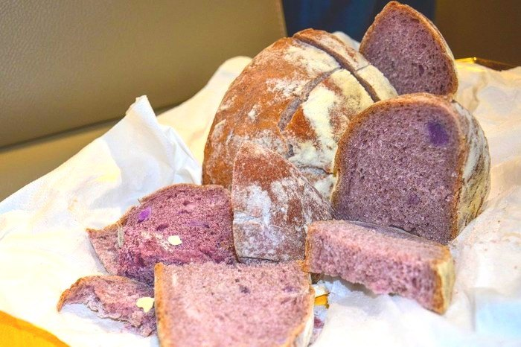
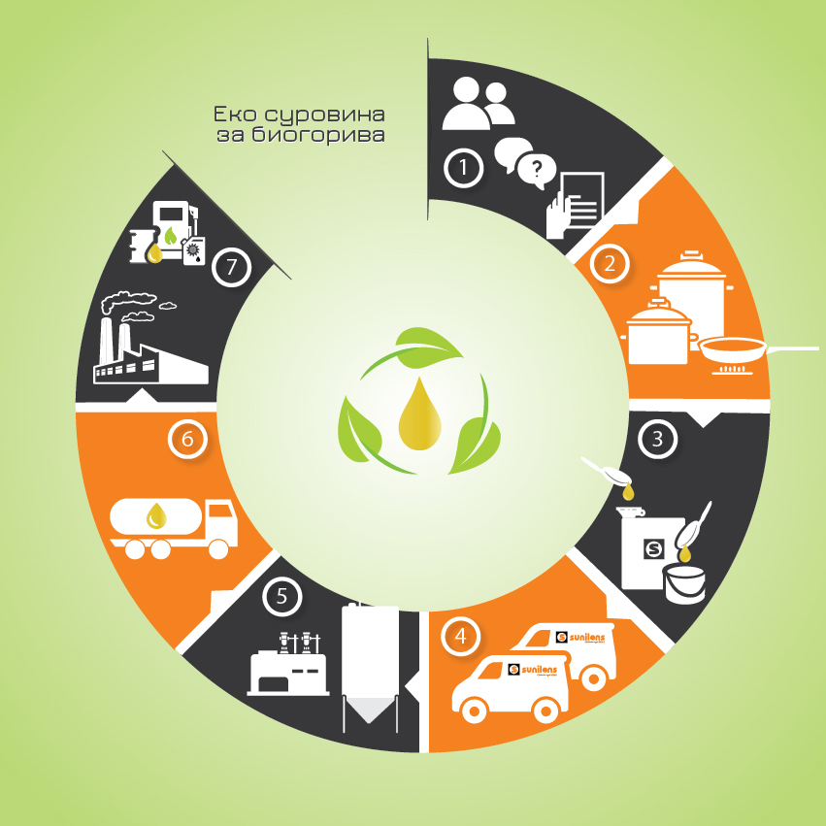
CE Initiatives in North Macedonia
“Green business ideas “ help for better environment: Extracting healthy ingredients from the grapes pomace: antioxidants, fibres and food colouring pigmentation.
From waste oil to energy: Eco system for used cooking oil recycling
In 2009, Sunilens introduced an innovative waste management system – collection, transportation, storage and treatment of used cooking oils and fats of vegetable origin.

Slide 6
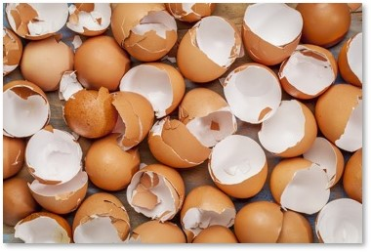
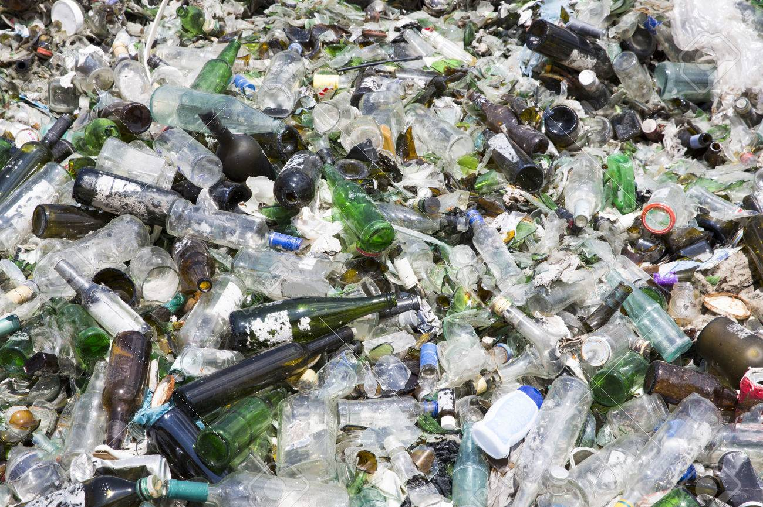
CE Initiatives in North Macedonia
Dietary supplements from egg shells: The company Bionovel produces calcium as a dietary supplement from egg shells. Egg shells are very similar to the structure of human bones, and the calcium contained in egg shells is most easily absorbed by the human body.
If you add value to waste glass, then you get to a profitable level...
Akron is a company that deals with waste glass. Most of their products end up in the North American market as a repro-material for the production of composite materials used for interior solutions.

Slide 7
Concluding notes
In the context of the approximation of RN Macedonia and alignment with the EU goals for introducing circular economy:
Enabling legal environment will be needed for companies to seriously consider circular economy;
Quality data generation (and availability) is prerequisite for designing evidence-based strategies and for further monitoring of the progress in any sector, including the developments in the sectors that are fundamental for the circular economy;
Cases of practicing circularity of recyclable materials and services in the chain of economic activities are not visible enough to trigger bigger impact, like in creating jobs and adding value;
The role of information provision, awareness raising, education, training and capacity building on the concept of circular economy should not be underestimated.

Slide 8
Thank you ☺

