Slide 1
Country Specific Findings
TURKEY
Regional Conference on Circular Economy 2020
This event was organized with the
financial support of the European Union.

Slide 2
Circular Economy in Turkey
The Zero Waste Project started in 2017 in Turkey by the Ministry of Environment and Urbanization. 18.750 public institutions joined the project and 126 tonnes of paper, 8,7 tonnes of glass were recycled while 9,1 tonnes of organic waste was composted until May 2019, reported by the Ministry of Environment.
The legal framework on waste management is largely harmonized according to the progress reports released by the Commission. Turkey has adopted a strategy that promotes a zero waste approach covering recycle and reuse, waste management, efficient use of natural resources, reduction of landfill. On the other hand, there is much progress needed in implementation wise.
This event was organized with the
financial support of the European Union.

Slide 3
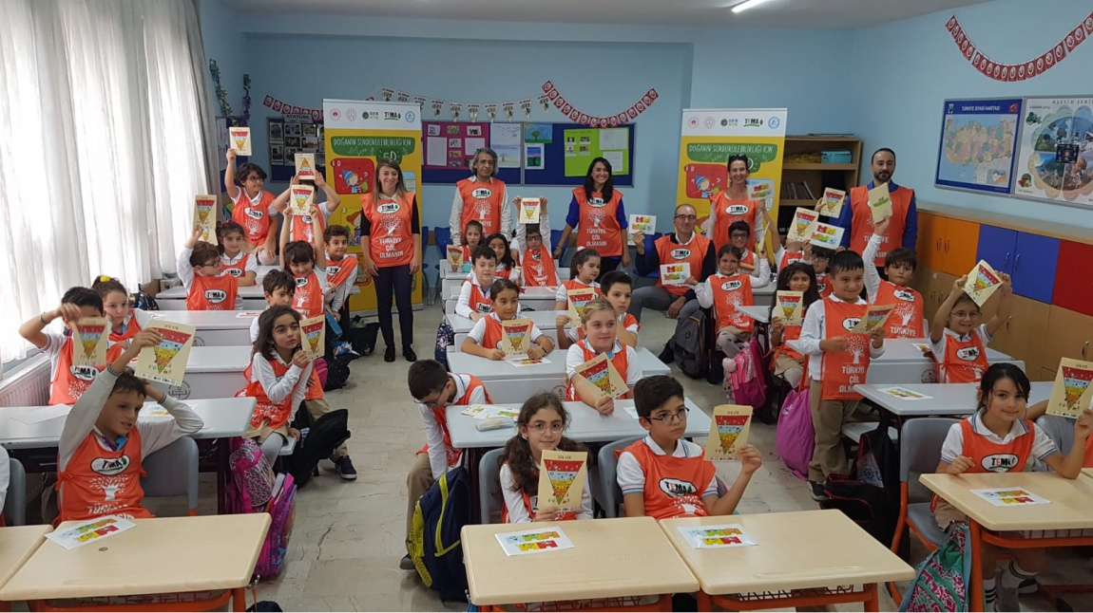

Slide 4
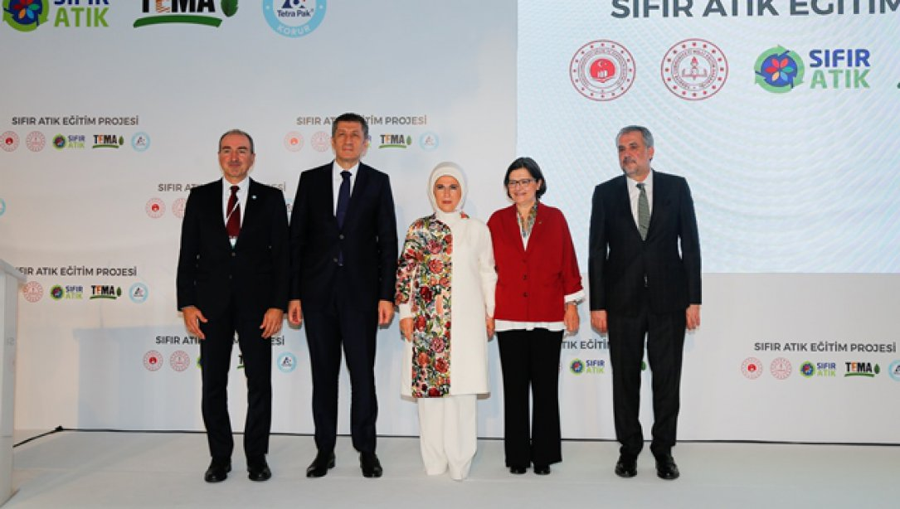

Slide 5
Circular Economy in Turkey
The ministry of Environment and Urbanization started working on “National Action Plan of Sustainable Consumption and Production Action Plan” in October 2019, with the technical support of Regional Environment Center Turkey (REC Turkey) and Regional Activity Center for Sustainable Consumption and Production (SCP / RAC). Firstly, a scoping meeting was held where public institution representatives participated in. The ministry shared the planning state, presented the prioritized lifecycle stages and the methodology in the meeting. Then, the participants provided inputs on policy tools for sustainable consumption and production for four sectors. The action planning work continued with the stakeholder workshop in December 2019.
This event was organized with the
financial support of the European Union.

Slide 6
Circular Economy in Turkey
The ministry of Environment and Urbanization started working on “National Action Plan of Sustainable Consumption and Production Action Plan” in October 2019, with the technical support of Regional Environment Center Turkey (REC Turkey) and Regional Activity Center for Sustainable Consumption and Production (SCP / RAC). Firstly, a scoping meeting was held where public institution representatives participated in. The ministry shared the planning state, presented the prioritized lifecycle stages and the methodology in the meeting. Then, the participants provided inputs on policy tools for sustainable consumption and production for four sectors. The action planning work continued with the stakeholder workshop in December 2019.
This event was organized with the
financial support of the European Union.

Slide 7
Circular Economy in Bussines Side
Turkey Materials Marketplace Project is a functional and innovative platform run by the cooperation between US Business Council for Sustainable Development (US BCSD) and Turkish Sustainable Development Association (Sürdürülebilir Kalkınma Derneği).
İstanbul Chamber of Industry (ICI) organized a meeting in September 2019. The business sector representatives from Turkey established an alliance against plastic pollution. Global Compact Turkey, Sürdürülebilir Kalkınma Derneği (SKD Turkey - Business Council for Sustainable Development Turkey) and Turkish Industry and Business Association (TUSİAD) founded the Business Plastic Initiative back in November 2020.
This event was organized with the
financial support of the European Union.

Slide 8
Thank You!
Gökçe AHİ
TEMA Foundation
gokce.ahi@tema.org.tr
This event was organized with the
financial support of the European Union.

