Slide 1



Country Specific Findings
Serbia
Regional Conference on Circular Economy 2020
Aleksandra Mladenovic
Environmental Ambassadors for Sustainable Development
Serbia
This event was organized with the
financial support of the European Union.

Slide 2
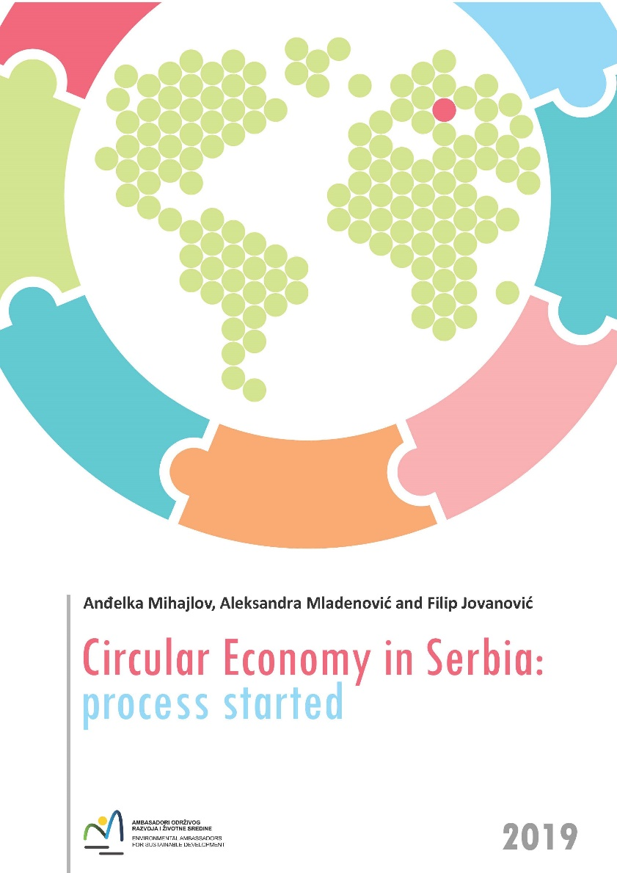
Circular Economy in Serbia: process started
Initiatives that support the circular economy are listed in the “Serbian National Profile 2018,” prepared by the Serbian Environmental Agency for the EEA 2018 edition of the “More from Less” report,
The Study on Achievements and Perspectives towards a Green Economy and Sustainable Growth in Serbia.
Circular Economy Actions/Initiatives spread over time in Serbia are presented in assessment developed under ENV.net3 project “Circular economy in Serbia: process started”
This event was organized with the
financial support of the European Union.

Slide 3
Conferences and workshops in Serbia have been held on the circular economy since 2002
the Workshop on Sustainable Consumption Opportunities, co-organized by the Serbian ministry for the environment and UNEP in March 2002 in Belgrade;
Conference EnE16 “Environment to Europe” Belgrade, June 2016;
Conference Circular Economy as a development opportunity for Serbia, Belgrade, November 2016, organized by the OSCE Mission in Serbia, the German Agency for International Cooperation GIZ, Serbian Chamber of Commerce and the Ministry for Environmental Protection;
ISWA World Congress 2016, Novi Sad “Circular Economy as an Opportunity to Improve Waste Management”.
.
This event was organized with the
financial support of the European Union.

Slide 4
Circular Economy in Serbia
Transition to the circular economy will help Serbia (and the region) to meet its international (and EU) commitments.
Not too much attention on the circular economy in Serbia; however, the trend is growing.
Number of articles with term “circular economy” in written media in Serbia
2011 | 2012 | 2013 | 2014 | 2015 | 2016 | 2017 | 2018 | 2019
0 | 2 | 3 | 5 | 18 | 20 | 21 | 40 | 80
This event was organized with the
financial support of the European Union.

Slide 5
There is no specific strategic document on the circular economy in Serbia, but…
Production and consumption | EU self-sufficiency for raw materials Green public procurement Waste generation Food waste | 13 documents
Waste management | Overall recycling rates Recycling rates for specific waste streams | 7 documents
Secondary raw materials | Contribution of recycled materials to raw materials demand Trade in recyclable raw materials | 8 documents
Competitiveness and innovation | Private investments, jobs and gross value added Patents | 7 documents
This event was organized with the
financial support of the European Union

Slide 6
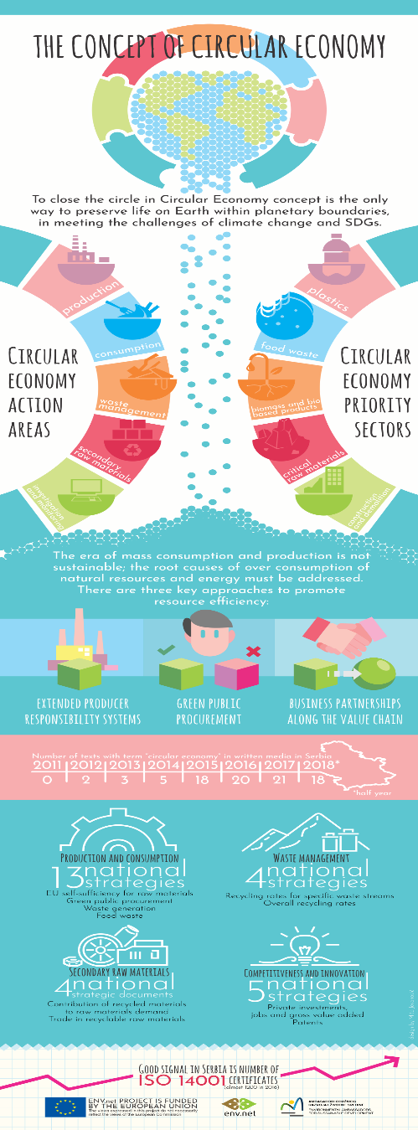
The circular economy concept in Serbia is still in its early stage
Serbia plans to refer to the circular economy principles in the updated waste strategy (ongoing). Ensuring a successful transition to the circular economy, however, requires efforts on many different fronts.
To underline:
circular economy goes beyond waste management
circular economy goes beyond SDG12
circular economy goes beyond environmental sector.
This event was organized with the
financial support of the European Union.

Slide 7
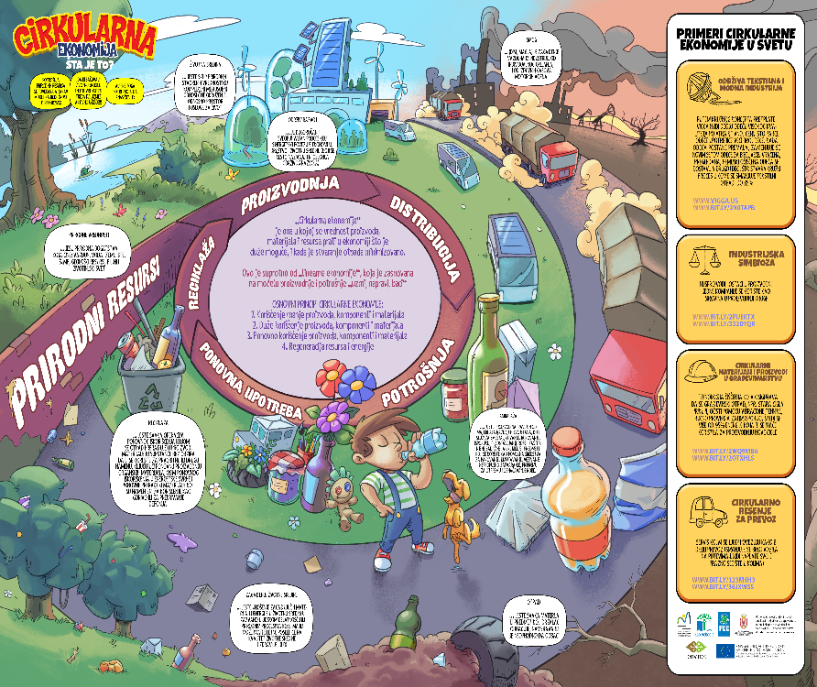
A possible strategy for the way forward
- Preparing the appropriate public policy paper for the circular economy
- Using the circular economy as a cornerstone of the industrial strategy
- Considering Initiatives to update and rethink the National Strategy for Sustainable Use of Natural Resources, possibly in the form of the National Sustainable Use of Natural Resources Plan;
- Updating the waste strategy, possibly in the form of the National Waste Management Plan
- Initiative to update and rethink Agenda 2030, possibly in the form of the Plan for Agenda 2030 implementation
- Considering new appropriate legislation
- Building/strengthening and monitoring the effectiveness of multi-stakeholder coalition to foster the circular economy process
- Accelerating the dissemination of knowledge and awareness-raising about circular economy topics.
This event was organized with the
financial support of the European Union.

Slide 8

Given that resource efficiency, circular economy, and raw materials supply are multidisciplinary areas, responsibilities are shared between ministries; there is a need for better cooperation between them, as well as improving the systemic approach.
Thank You!
www.ambassadors-env.com
This event was organized with the
financial support of the European Union.

