Slide 1
Country Specific Findings Republic of North Macedonia
Regional Conference on Circular Economy 2020
This event was organized with the
financial support of the European Union.

Slide 2
Circular Economy in Macedonia: Current context
In the Republic of North Macedonia, even though the notion of “circular economy” has only recently (and explicitly) entered in the legal framework the concept of circularity in the economy is not entirely new.
The use of secondary row materials as resources, in particular various types of metal and paper, has been long present in the country economic cycle of production and trading activities.
The current legal environment that profiles the circularity of the economy, defined by a corpus of laws, regulations, and strategic national documents and action plans, does provide basis for implementation of the concept of circular economy in the country.
The interest of the wider society, including scholars, researchers, NGOs and media, relating to circular economy potentials and practices in the country has also been present and increasing in the past several years, manifested in a form of case studies, conferences, media articles and CSO initiatives that explicitly target the concept of circular economy.

Slide 3
Current context - Legislation
Production and consumption | Waste management | Secondary raw materials | Competitiveness and innovation
National Strategy on Sustainable Development (2010) National Strategy for Sustainable Development of Forestry (2006); National Strategy for Clean Development Mechanism (2007) National Strategy for Environmental Approximation (2008) NPAA 2017 (2017-2019) Strategy for Renewable Resources (2010); Strategy for Energy Efficiency (until 2020); Water Strategy; National Strategy for Clean Development Mechanism (2007) Economic reforms (2018-2020) Law on Public Procurements (2018) - new, Law on Waste Management (2018) - new Waste Management Strategy (2008-2020) National Plan for Waste Management (2009-2015) – outdated Regional and local waste management plans National Waste Management Plan (2018-20140) - new Plan for Prevention of Waste Generation (2018-20140) - new Electrical and Electronic Waste Management Plan with feasibility study (2013 – 2020) Plan for closing of non-compliant landfills in the Republic of Macedonia (2011) Law on Food Safety (2010) & a corpus of legal acts related to food | Waste Management Strategy (2008-2020) Law on Waste Management (2018) – new Law on packaging and packaging waste Management (2009) Law on batteries and accumulators waste management (2010) Law on electrical and electronic equipment waste management (2012) National Plan for Waste Management (2009-2015) – outdated Regional and local waste management plans National Waste Management Plan (2018-20140) - new Plan for Prevention of Waste Generation (2018-20140) - new Electrical and Electronic Waste Management Plan with feasibility study (2013 – 2020) Program for packaging waste management (2011-2020) Set of Rulebooks on transposing Landfill Directive (1999/31) draft Law on Extended Producer Responsibility for Management of Special Waste Streams (2019) | Waste Management Strategy (2008-2020) National Strategy for Clean Development Mechanism (2007) Set of Rulebooks on eco labelling (food, chemicals, textile, wood, detergents, tourists accommodation) Rulebook on the form and content of the forms for transboundary waste transfer Note: Import of waste that can be safely processed, used as a raw material or used as a source of energy is permitted. Export of waste that can be processed and disposed of without any hazard to the environment, human life and health in the importing country is permitted. Import, export and transit of hazardous waste in the Republic of Macedonia is performed according to the Basel Convention on the Control of Transboundary Movement of Hazardous Waste and its storage. The latest amendments of the Law on Waste Management from Jan.2020forbid import of any waste to be used for energy source | Economic reforms (2018-2020) Industrial Strategy with a focus on the Manufacturing Sector (2018) – draft Law on Financial Support of Investments (2018) – new Horizon 2020 (Financial support from the clean development mechanism for the construction and development of bio-digesters, 2016) Fund for Innovations and Technology Development (support for micro, small and medium size enterprises) Note: At the European Innovative Ranking List (2019) the Republic of North Macedonia is assessed as a "modest innovator", with progress in relative performance compared to EU in 2011 by 5.5 index points), but 3.5 index points behind compared to EU in 2018. EIS 2019, Country profiles https://ec.europa.eu/docsroom/documents/35904

Slide 4
Findings
Using the approach and logic of the EU proposed Monitoring framework and indicators, the assessment of the situation in 2018 is presented under the following stages and aspects of the circular economy:
Production and consumption - Limited progress can be observed towards more circular trends in production and consumption, in terms of waste generation.
Waste Management - Waste management generally shows slow but positive developments, yet with significant room for improvement for recycling across the key waste streams.
Secondary raw materials - The contribution of recycled materials to overall materials demand is relatively low. Trade in secondary raw materials is increasing.
Competitiveness and innovation - Republic of North Macedonia is categorised as a "modest innovator" compared to other European countries (Over time, performance has increased relative to that of the EU in 2011 and in 2018).

Slide 5
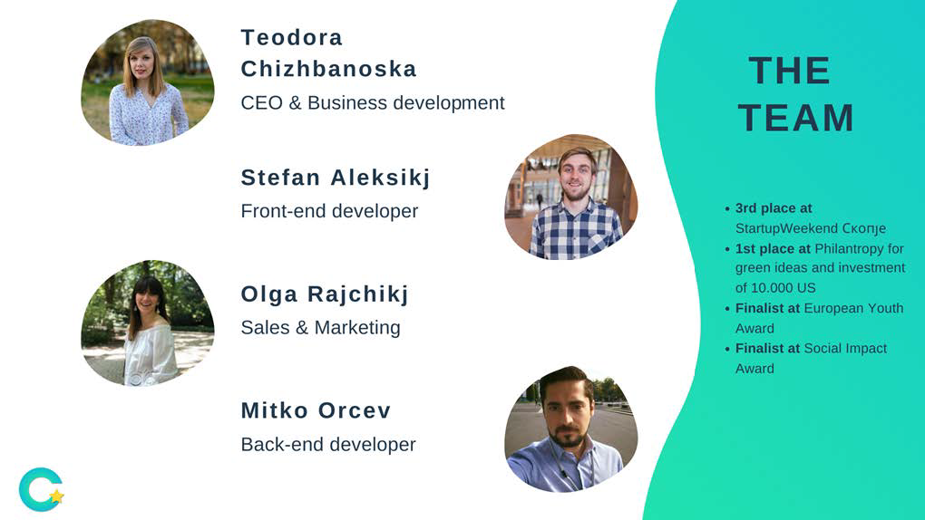
CE Initiatives in Macedonia
Green business ideas help for better environment…
The mobile application Challenger has one main purpose - to get people to leave their cars at home and to motivate them to walk more, ride more often their bikes, and in return get a reward. (https://challenger.mk/)
The idea behind this green business idea and application was originally born out of the problem with air pollution in Skopje.
It offers:
- Accurate statistics on mileage and CO₂ emissions saved with every challenge.
A new type of green marketing channel to local business: by offering discounts they receive recognition of being socially responsible.
Target market that includes both small local business and medium to large companies.
Potentials for regional expansion.
Video: https://www.youtube.com/watch?v=SKlzzYk5j4s

Slide 6
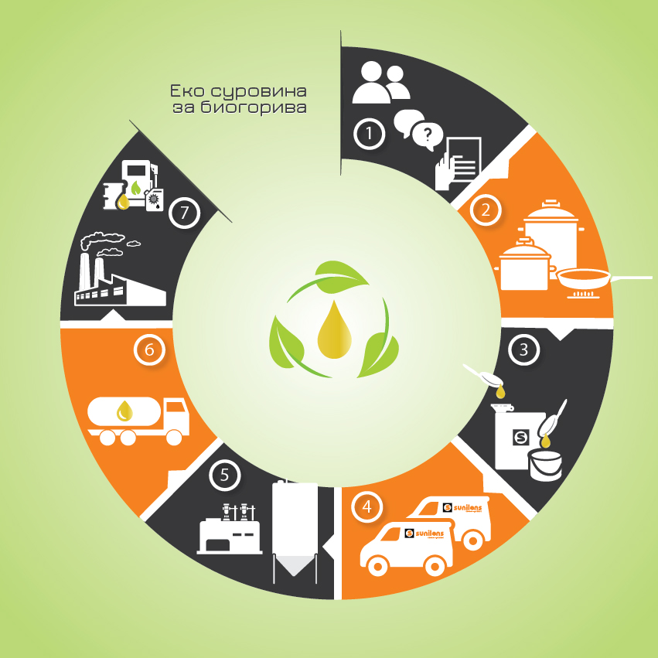
CE Initiatives in Macedonia
From waste oil to energy: Eco system for used cooking oil recycling
In 2009, Sunilens introduced an innovative waste management system – collection, transportation, storage and treatment of used cooking oils and fats of vegetable origin.
By using modern technology, developed logistics network and continued education of used cooking oil producers, their system guarantees further utilisation of the energy potential of UCO – as feedstock for production of renewable energy (biofuels). With this circular, green energy business model they contribute to cleaner environment, and mitigation of climate change challenges.
https://sunilens.com.mk/en/used-cooking-oil/.

Slide 7
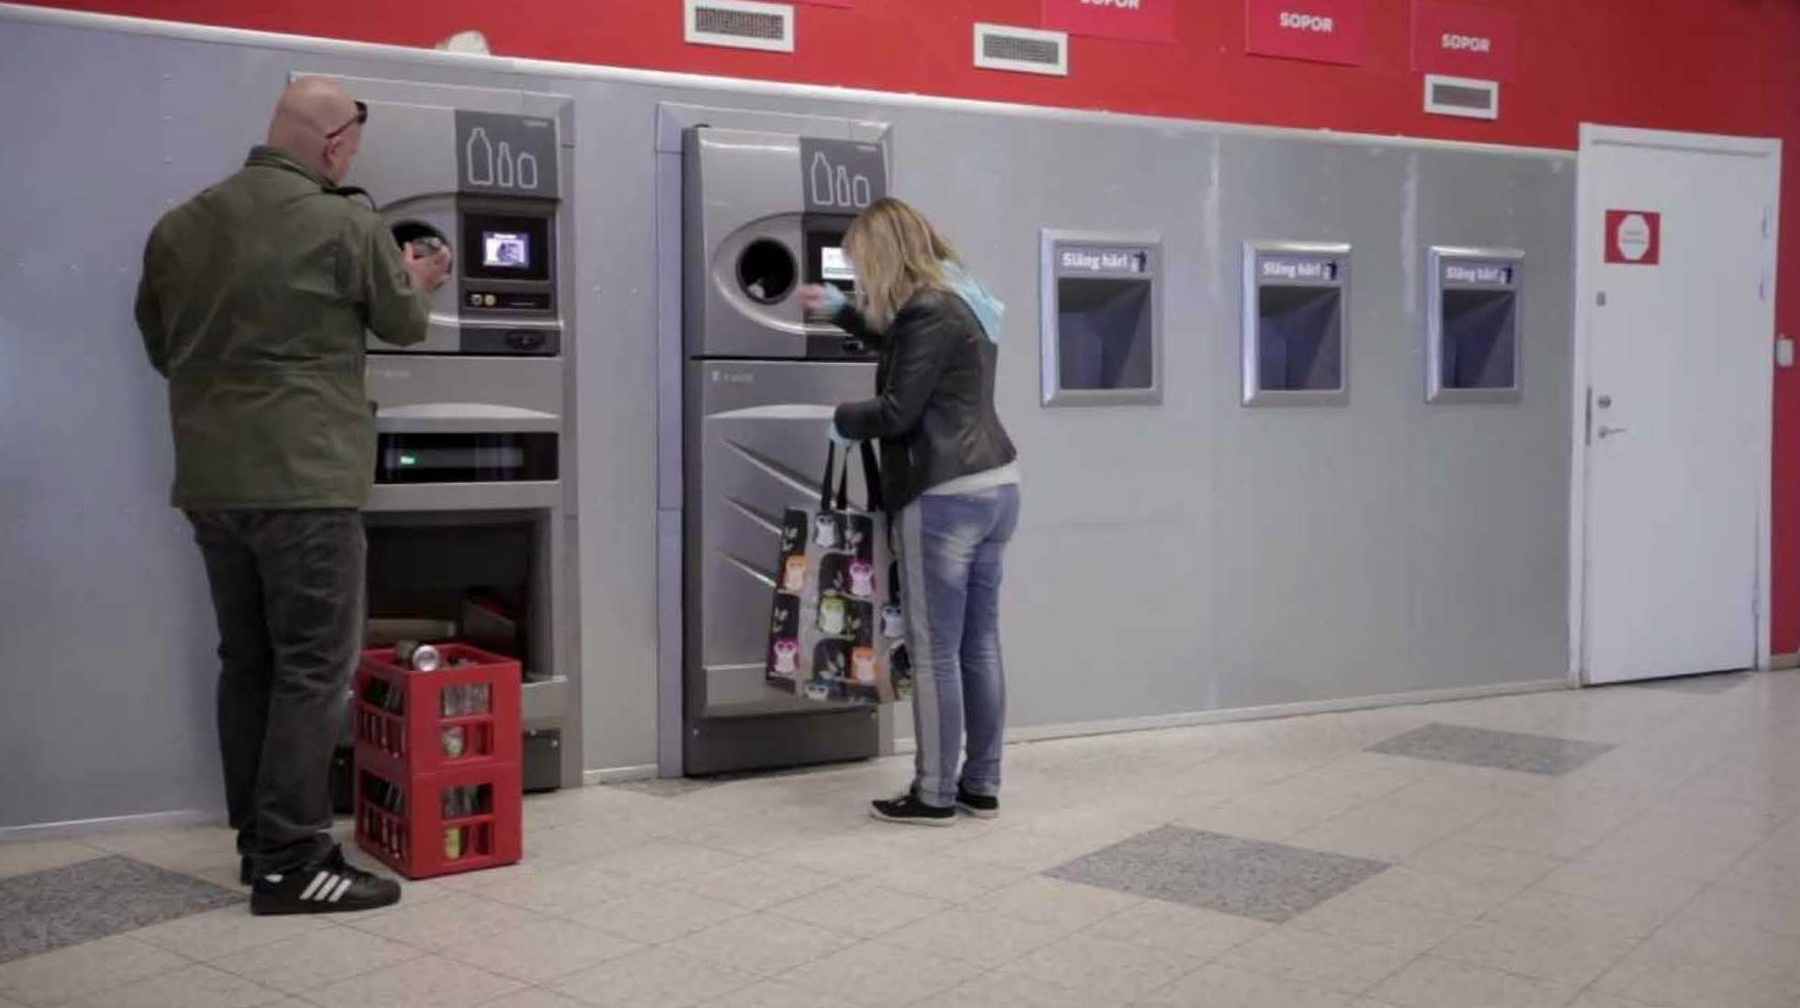
CE Initiatives in Macedonia
New “Trash for Cash” initiative
Reverse Vending” machines. They operate on the same principle as standard vending machines (put money, get output), but are called a "reverse vending machine" due to the reverse process (put a product, get a money return). About a year ago, a similar system was introduced in Istanbul, Turkey, allowing citizens to fill up their public transportation cards by returning plastic bottles and aluminium beverage cans.
The initiative of Pakomak to introduce reverse vending machines (RVMs) for plastic bottles and aluminium cans in our country is supported by the State Fund for Innovation and Technology Development. The deployment of the first prototype is expected in the first half of 2020. In exchange for deposited beverage containers, the machines will issue “green points” that can be used to pay for products and public services, such as utility bills, public transit fares, and parking. This is a novelty (we have never had such a project on the territory of Macedonia so far) and it is a real innovation in the field of municipal waste collection and recycling.

Slide 8
Concluding notes
Enabling legal environment will be needed for companies to seriously consider circular economy;
Quality data generation (and availability) is prerequisite for designing evidence-based strategies and for further monitoring of the progress in any sector, including the developments in the sectors that are fundamental for the circular economy;
Cases of practicing circularity of recyclable materials and services in the chain of economic activities are not visible enough to trigger bigger impact, like in creating jobs and adding value;
The role of information provision, awareness raising, education, training and capacity building on the concept of circular economy should not be underestimated.

Slide 9
Thank you ☺

